Slide 1
Particle Systems
CS 460: COMPUTER GRAPHICS

Slide 2
Lecture outline
What are Particle systems?
2. Mathematics and Physics in Particle systems
Implementation of Particle Dynamics
Rendering Issues for Particle systems
Examples:
http://www.youtube.com/watch?v=0aJ7EhES7Ig
http://www.youtube.com/watch?v=7wWsYTYGX78
Notes:
http://www.youtube.com/watch?v=lV29ien83PM (simple)
http://www.youtube.com/watch?v=0aJ7EhES7Ig (waterfall)
http://www.youtube.com/watch?v=7wWsYTYGX78 (complex)

Slide 3
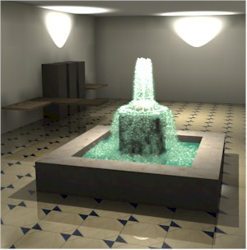
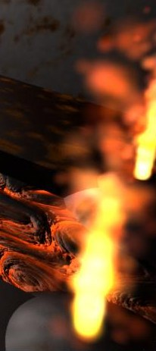
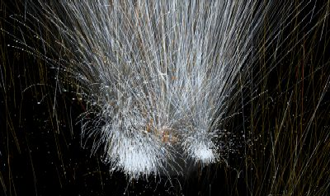
What are particle systems?
A particle system is a collection of point masses that obeys some physical laws (e.g. gravity or spring behaviors)
Particle systems can be used to simulate all sorts of physical phenomena:
  Smoke
  Snow and Water Flow
  Fireworks & Explosion
  Hair
  Cloth
  Snakes and Fishes (non-rigid bodies)
  Gas, etc.
Used heavily in computer games
[from UNC]
Notes:
http://www.youtube.com/watch?v=dX8KeqYLY10 (smoke)
http://www.youtube.com/watch?v=z6ndotWv0Us (snow)
http://www.youtube.com/watch?v=XX5JO91WXXk (fireworks)
http://www.youtube.com/watch?v=kc7rd8zgukw (hair)

Slide 4
What are particle systems?
Note that although the dynamics of a simple particle system are based on each particle being treated as a point mass, the user can specify how each particle is rendered.
Each particle may represent a person in a crowd scene, or a molecule in a chemical-synthesis application, or a portion of a cloth piece in the simulation of a flag blowing in the wind.
  E.g. a particle can be rendered as GL_POINT, GL_LINE, a textured polygon, a 3D model, etc.
Notes:
http://www.youtube.com/watch?v=SgaVCSF4LpM

Slide 5
What are particle systems?
There are two issues in Particle systems:
  Particle Dynamics (Simulation)
    Setup the physical rules for particle dynamics
    Animate the particles
2. Particles Rendering
    Render each particle
    Render all particles as a whole (e.g. fish)

Slide 6
Particle Dynamics
One lousy particle
Particle systems (A network of Particles)
Forces: gravity, springs, etc.
Implementation

Slide 7
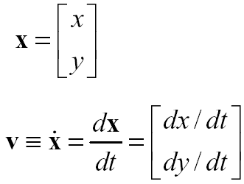
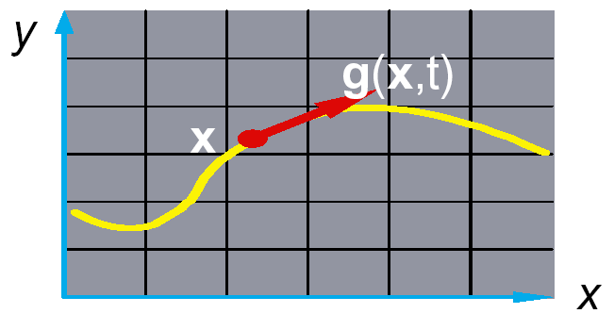

Particle in a flow field
Let’s consider the 2D case first.
We begin with a single particle with
  position,
  velocity,
Suppose the velocity is dictated by
some driving function g:
Note: vectors in boldface
g(x,y,t)

Slide 8
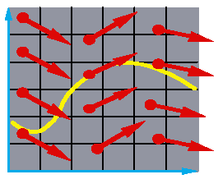
Vector fields
At any moment in time t, the function g defines a vector field over x:
How does our particle move through the vector field?

Slide 9
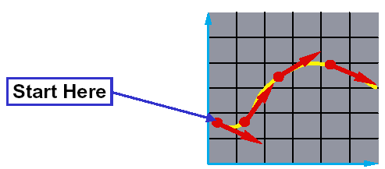
Rate of change
The equation x = g (x, t) is actually a first order (ordinary) differential equation.
We can solve for x(t) through time by starting at an initial point and stepping along the vector field:
This is called an initial value problem and the solution is called an integral curve.

Slide 10
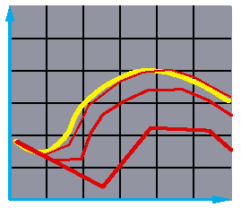


Euler’s Method
One simple approach is to choose a time step, Δt, and take linear steps along the flow:
This approach is called Euler’s method.
Properties:
  Simple numerical method
  Bigger steps, bigger errors
Need to take pretty small steps, so not very efficient.
Better (more complicated) methods exist. e.g. “Runge-Kutta.”

Slide 11
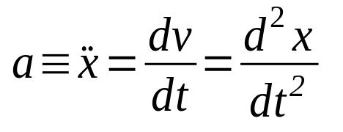


Particle in a force field
Now consider a particle in a force field f.
In this case, the particle has:
  mass, m
  acceleration,
The particle obeys Newton’s law:
The force field f can in general depend on the position and velocity of the particle as well as time.
Thus, with some rearrangement, we end up with:

Slide 12
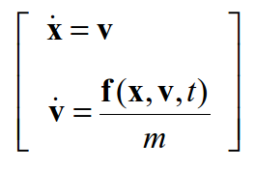
Second order equations
This equation: is a second order differential equation.
Our solution method, though, worked on first order differential equations.
We can rewrite this as:
where we have added a new variable v to get a pair of coupled first order equations.

Slide 13
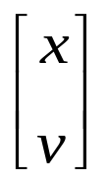
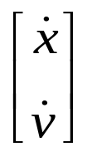
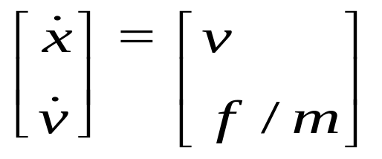
Phase Space
Let’s consider the 3D case from now on.
Concatenate x and v to make a 6-vector.
Taking the time derivative: another 6-vector
A 1st-order differential equation.

Slide 14
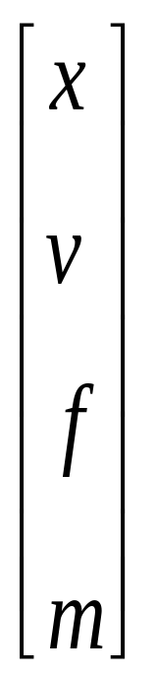
Particle Structure
Each particle has:
Position
in phase space
position
velocity
force accumulator
mass

Slide 15
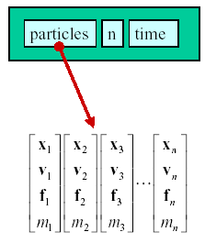
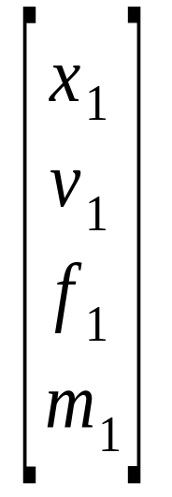
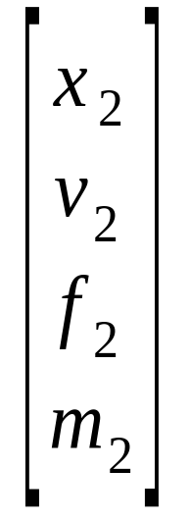
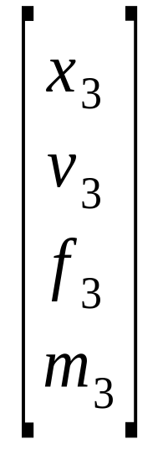
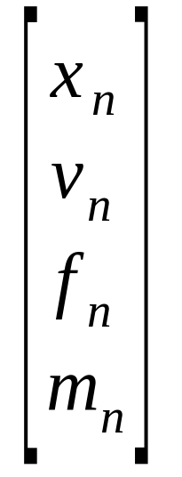
Particle Systems
Note: n particles

Slide 16
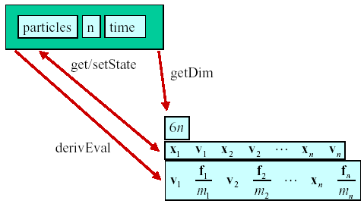
Solver Interface
General Steps:
Retrieve current x, v and a
Compute new x and v
Note: e.g., use Euler’s Method.
get/setState
getNPart
n
derivEval

Slide 17
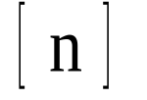
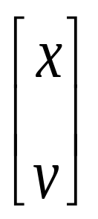
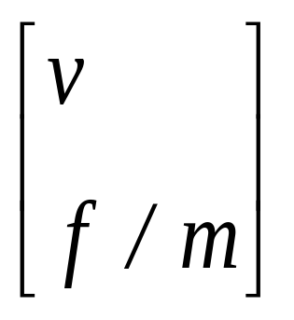
Solver Interface
getNPart
getState
setState
derivEval

Slide 18
Forces
Constant (gravity)
Position/time dependent (force fields)
Velocity-dependent (drag)
N-ary (springs)
This is for computing a in the above slide because f may change according to x, t, etc.
Notes:
http://www.youtube.com/watch?v=yjMrGj2eV7M&NR=1 (explosion)

Slide 19

Gravity
Force law: f_{grav} = m G
Note: on Earth’s surface.
Otherwise… f = GMm / r².
Notes:
http://www.youtube.com/watch?v=V1KNNmDGWY8 (in space)
http://www.youtube.com/watch?v=0i7CNqgG1OU (more particles)

Slide 20

Viscous drag
Force law: f_{drag} = -k_{drag} v

Slide 21
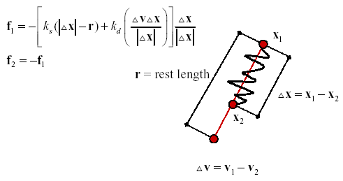
Damped spring
Force law (Hooke’s Law):
By Newton’s 3rd Law
Notes:
http://www.youtube.com/watch?v=lyyv0FSu2mk (povray)
http://www.youtube.com/watch?v=rshi4gQN1B8 (mesh)
http://www.youtube.com/watch?v=8uB2GLpxprM (cloth)

Slide 22
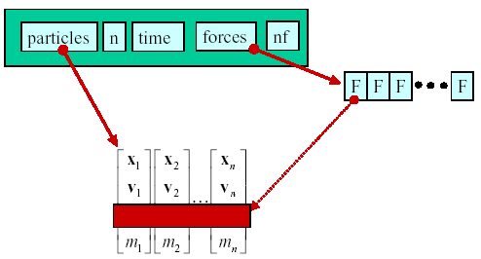
Particle systems with forces
f₁
f₂
f_{n}

Slide 23
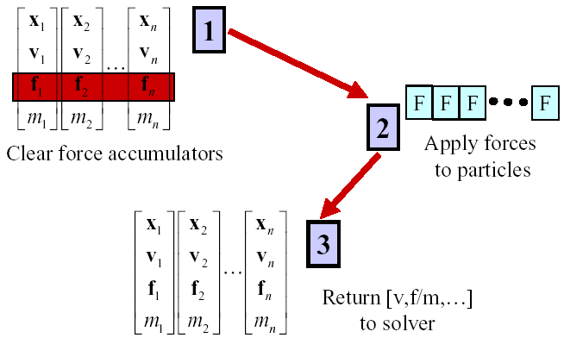
derivEval loop
1->2: find all forces acted
on each particle
2->3: find the resultant force

Slide 24
derivEval loop
Clear forces
  Loop over particles, zero force accumulators
Calculate resultant forces
  Sum all forces into accumulators
Gather
  Loop over particles, copying v and f/m into destination array

Slide 25
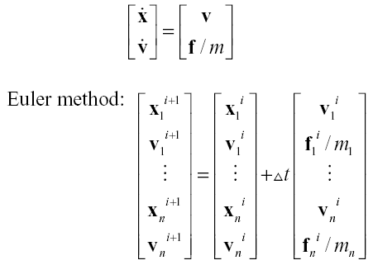
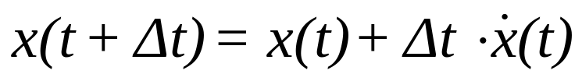
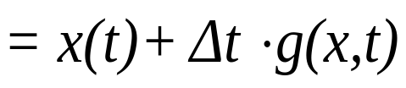
Differential Equation Solver

Slide 26
Summary
float time, delta;
float state[6n], force[3n];
state = get_initial_state();
for(time=t0;time<time_final;time+=delta) {
/* compute forces */
force=force_function (state,time);
/* apply ODE solver */
state = ode(force,state,time,delta);
/* display result */
render(state,time);
}
// state per particle is v and x

Slide 27
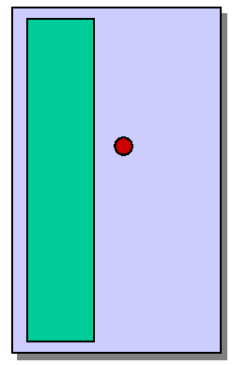
Bouncing off the walls
Add-on for a particle simulator
For now, just simple point-plane collisions
Notes:
http://www.youtube.com/watch?v=qHnpKI1ejQg (plane approx)

Slide 28
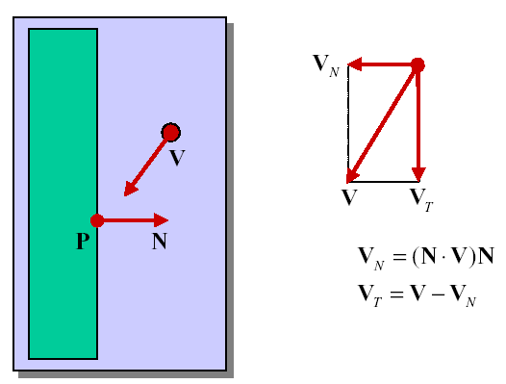
Normal and tangent components
Note: N is a unit vector.

Slide 29
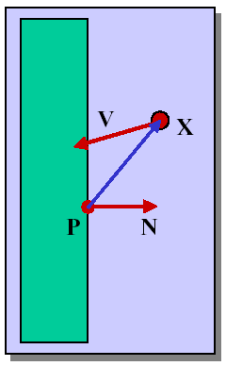

Collision Detection

Slide 30
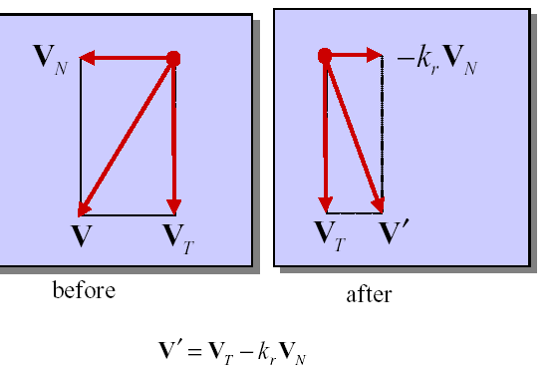
Collision Response
Notes:
http://www.youtube.com/watch?v=0YzOIKPooHk (particle vs. object)
http://www.youtube.com/watch?v=Yb-C4CuvlXU (particle vs. particle)
http://www.youtube.com/watch?v=BP6C8-UZWzc (mixed)
http://www.youtube.com/watch?v=hp-wsEI3l-U(with cloth and collision)
http://www.youtube.com/watch?v=qDsdQv0xiyk (with cloth and cow)

Slide 31
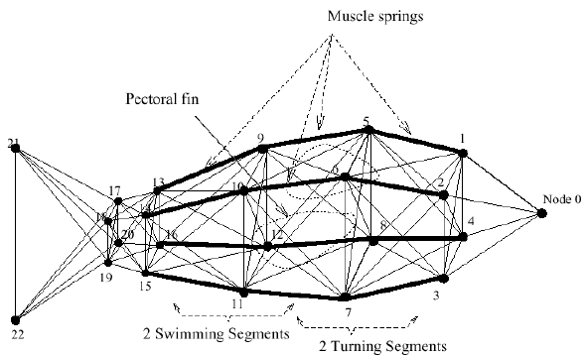
Example: Artificial Fish
https://www.youtube.com/watch?v=nYlt-jl0ikI

Slide 32
Summary: Particle Dynamics
What you should take from this part:
The meaning of all the boldfaced terms
Euler’s method for solving differential equations
Combining particles into a particle system
Physics of a particle system
Various forces acting on a particle
Simple collision detection and collision response

Slide 33
Rendering Issues
Simple & Efficient rendering for particles
  There are usually a large number of particles
  One simple way is to render particles as GL_POINTS
Level of Detail if we use 3D models
Textured polygon (Billboard) is a common choice
  Since graphics hardware is optimized for rendering small textured triangles, rendering textured triangles is almost as fast as anti-aliased GL_POINTS (provided you have graphics hardware support)

Slide 34
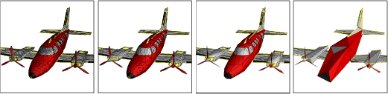
Rendering: Level of Detail
[Hoppe]
Around 1976, Clark suggested using simpler versions of the geometry for objects that had lesser visual importance, such as those which are far away from the viewer
Thus, for particle systems using 3D models as particles, we should use level of detail technique so as to improve rendering performance.
Note: level of detail can be used not only for particle system, but for modeling and rendering complex 3D objects in general.

Slide 35
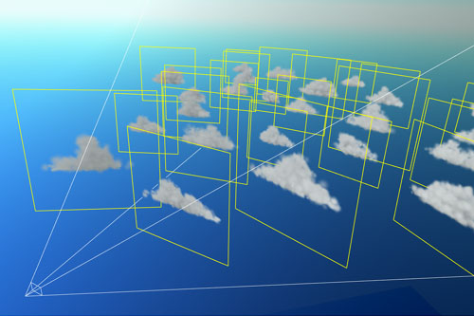
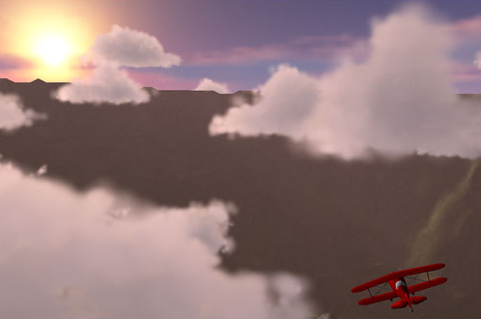
Rendering: Textured Billboard
Billboards are basically 2D viewpoint-facing textured polygons (e.g. quad.) that are used to represent 3D geometry
[Harris]

Slide 36



Rendering: Textured Billboard
Typically in particle system, use small texture,
e.g. size = 32 x 32.
Produce different color/intensity/transparency for different particles.
And if particles are transparent, we need to sort them and render from back to front!!!
red
green

Slide 37
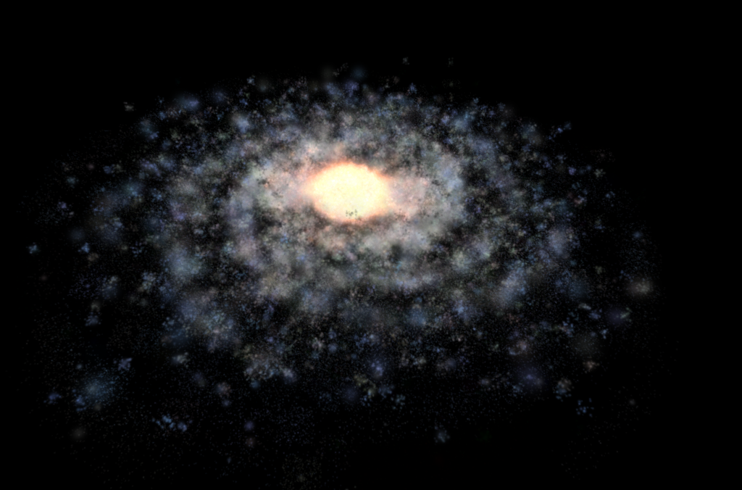
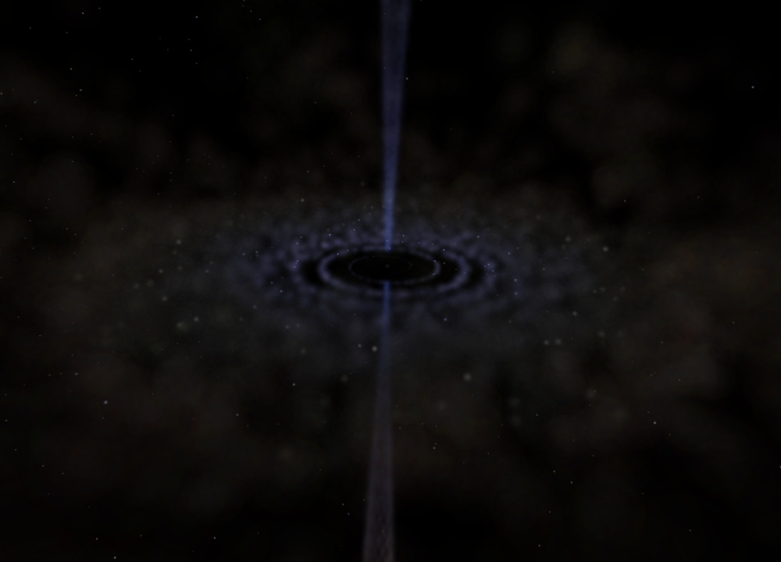
Rendering: Textured Billboard
E.g., Milky Way Galaxy Model and Black-hole Simulation using particle system:
[Philip]
~ 433K particles
~ 50K particles

Slide 38
Further reading
http://www.cs.cmu.edu/~baraff/sigcourse/notesf.pdf

